Slide 1
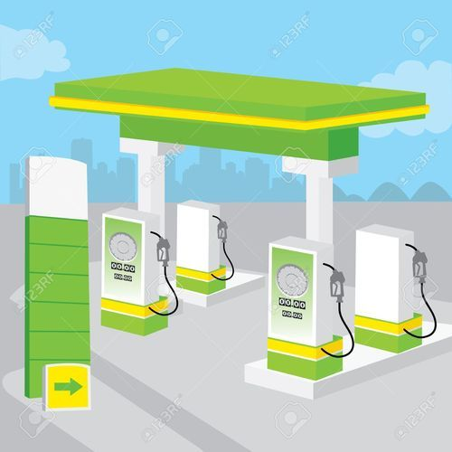

Slide 2


Group-83

Slide 3
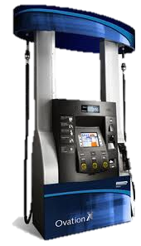



ABHISHEK THAPLIYAL-20BCE10231
PRESENTERS
GAURAV SAHU-20BCE11043
ANIKET KHARE-20BCE10363
SNEHA AGARWAL-20BCE10635
UTKARSH KUMAR-20BCE10622

Slide 4

01
03
02
04
Overview
Advantages & Requirements
Limitations &
Novelty
Real Time Usage

Slide 5

INTRODUCTION
The idea of our Petrol pump management system is mainly to manage daily records of petrol pump. Using this system the admin will be able to check the employee attendance, quantity of petrol and diesel sold in any day, week or month.
We can also set the rating for petrol and diesel for that day as we know that it varies from day to day.
User can generate reports easily form this petrol pump management system.

Slide 6
REAL TIME USAGE
As we know usually The management of the petrol pump is done by the manager manually, so here we are developing a software that is a Petrol pump management system .
This software is stand alone application useful for petrol pumps to this petrol pump management system will be .This will be useful for viewing the information of all the pump available in the petrol pump .
So overall our idea is to develop a software that help us from switching from manual work to database .So that less man force is required and glitches can be minimized.

Slide 7
PROPOSED PETROL PUMP MANAGEMENT SYSTEM
As the work at petrol pump is done manually so it becomes hard for the supervisor to maintain a daily record. So we have developed this system to computerize all the reporting work of petrol pump.
From report module admin can also generate several reports like pumps daily earning report , employee shift delivery report , pumps report , cumulative daily report , salary report, amount of fuel sold . Admin can update many information in the system that’s why his account is protected with user name and password. Only authentic user can login to admin account.

Slide 8


EXISTING SYSTEM
In present system all report work is done manually at the petrol pump. Admin user have to check each petrol pump machine the calculate the sold petrol, but in our proposed system user can check sold petrol from his monitor by clicking on some report button. Admin can also check which employee sold how much petrol and what amount he submitted to accountant at the end of the day. Admin can also check how much oil they sold in one day or one month. Admin can generate monthly sale report or annually sale report when they want. This system also help admin to generate the salary of each employee on the basis of his position and working hour.

Slide 9


LIMITATIONS OF EXISTING SYSTEM
Most of details are maintained manually. Due to this the data retrieved is time consuming. Due to human calculation errors occur.
Even when the data is maintained on spreadsheet inconsistency occurs as an order might be missed or wrongly entered or twice.
Data are stride an excel sheet which takes lot of time and data may be corrupted.
As storage and exchange of data is achieved only by use of excel sheets which lack validation
capabilities, there is always risk of invalid, inaccurate or incomplete data being fed in computer.
Difficulty in managing multiple forms.
Lack of security.

Slide 10




NOVELTY OF THE PROJECT
All the information about sale, purchase, stock will be maintain properly in this system.
All manual calculation of sale or all the money management will be performed by the computer automatically.
This system will provide timely report information.
It will produce report for sale, bill and stock information.
The computer can hold amount of data in its storage device

Slide 11





ADVANTAGE OF PROPOSED SYSTEM
A database application can be stored in computer effectively.
No cheating in the numbers can be done.
Whenever rates will fluctuate on time changes would be made.
Time management.
No need to check manually the quantity left
Cheating can be minimized

Slide 12



SYSTEM REQUIREMENT
Software Specification:-
Software requirements for this system
are as listed follows:--
basically we will be using cpp
language to develop this code as
it will be user friendly and
technically it will easier to excess
and operate. And the platform used
is Turbo C++.

Slide 13
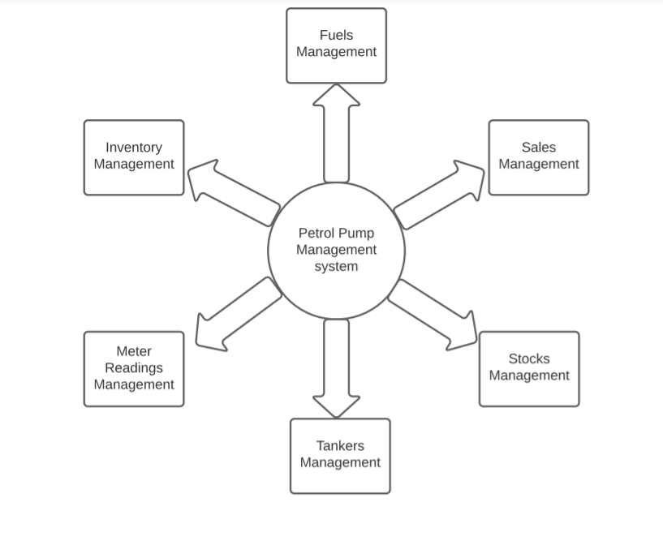
FLOW DIAGRAM

Slide 14

THANK YOU

